Slide 1
UNIT -3

Slide 2
From 2D to 3D
  Translation, scaling
  Homogeneous vectors: one extra coordinate
  Matrices: 4x4
Rotation more complex

Slide 3
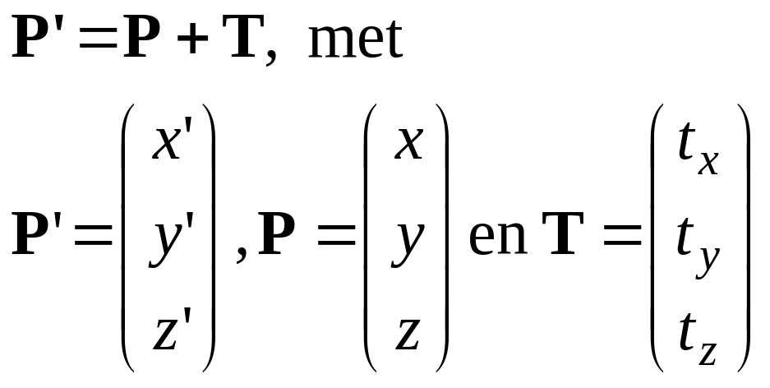
3D Translation 1
Translate over vector (t_{x}, t_{y,} t_{z} ):
x’=x+ t_{x}, y’=y+ t_{y} , z’=z+ t_{z}
or
y
P+T
T
P
x
z

Slide 4
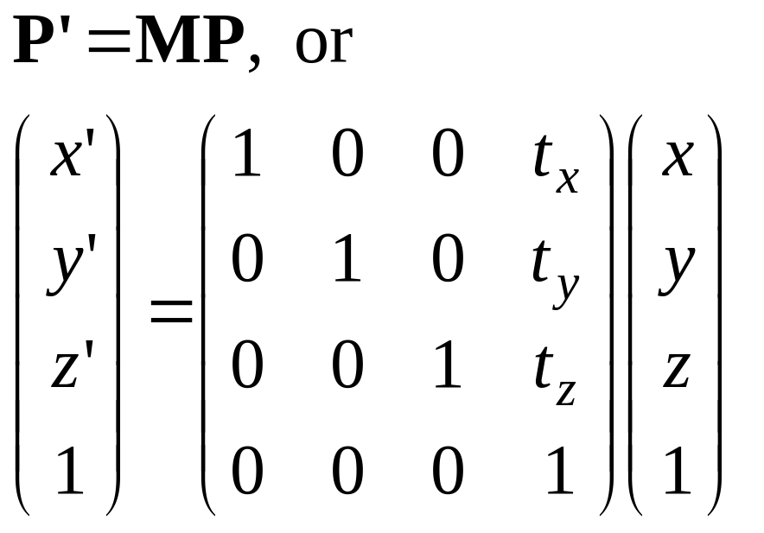
3D Translation 2
In 4D homogeneous coordinates:
y
P+T
T
P
x
z

Slide 5
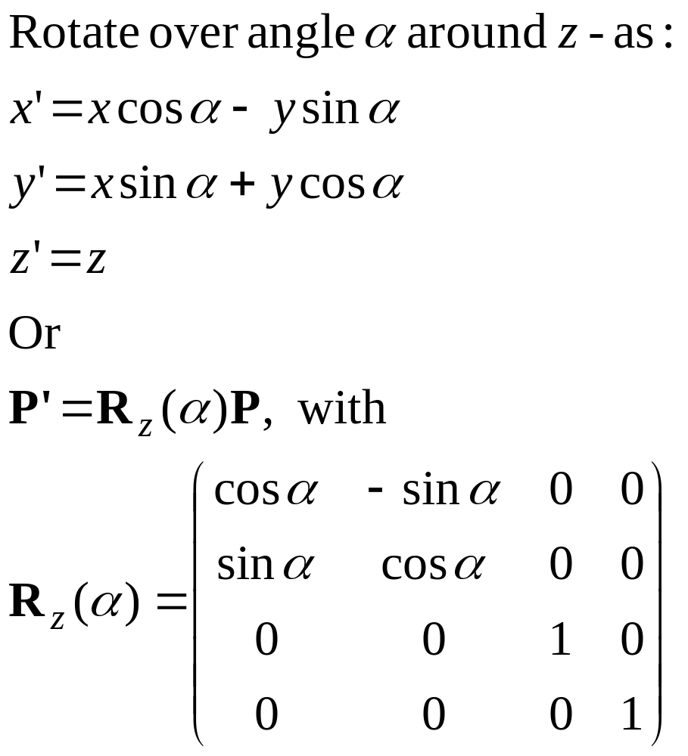
3D Rotation 1
z
y
P’
α
P
x

Slide 6
3D Rotation 2
z
y
z
y
z
y
x
x
x
Rotation around axis:
Counterclockwise, viewed from rotation axis

Slide 7
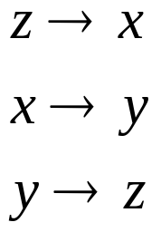
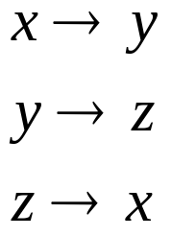

3D Rotation 3
z
z
y
z
y
y
x
x
x
Rotation around axes:
Cyclic permutation coordinate axes

Slide 8

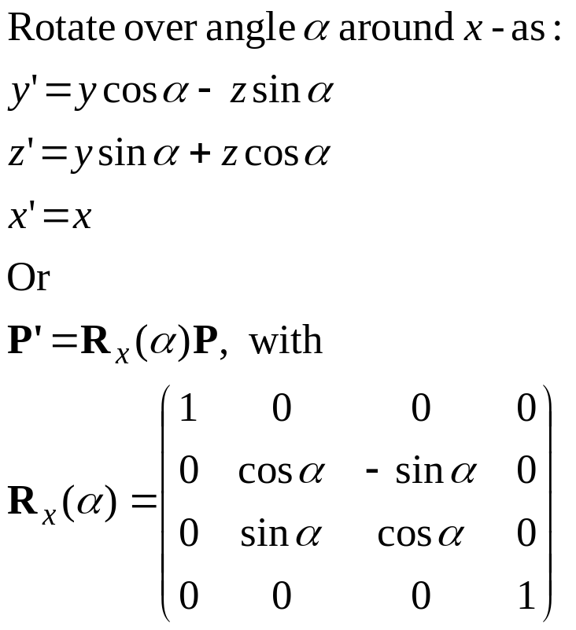
3D Rotatie 4

Slide 9
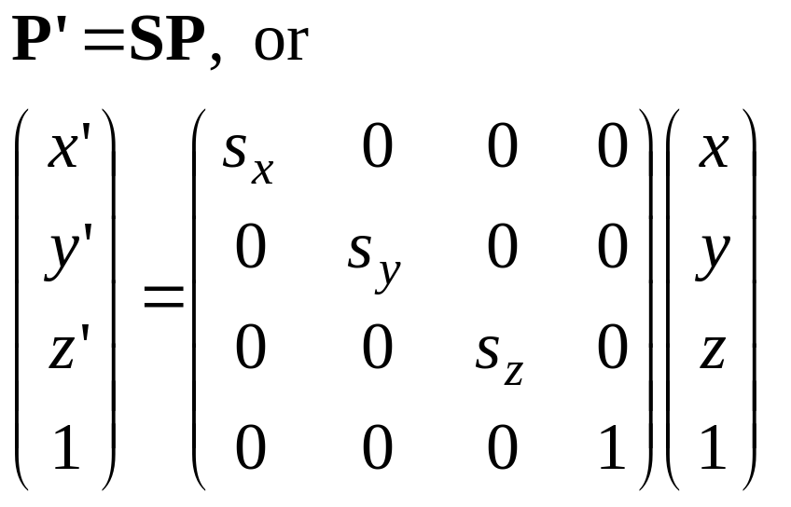
3D scaling
Scale with factors s_{x}, s_{y},s_{z} :
x’= s_{x} x, y’= s_{y} y, z’= s_{z} z
or

Slide 10
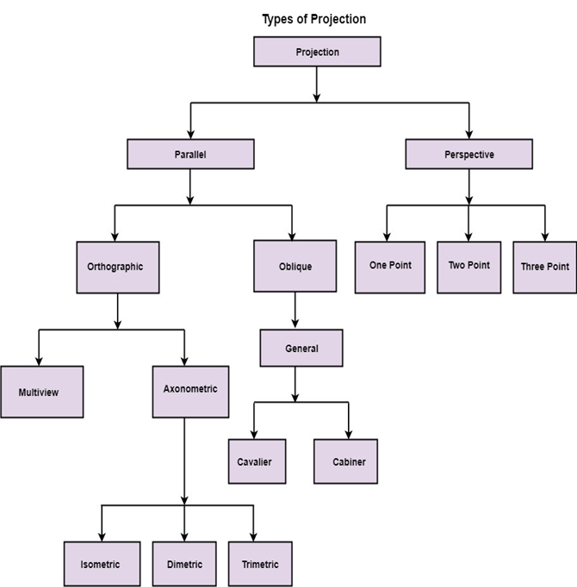


Slide 11
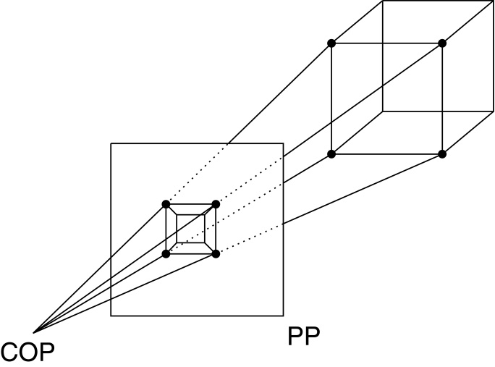
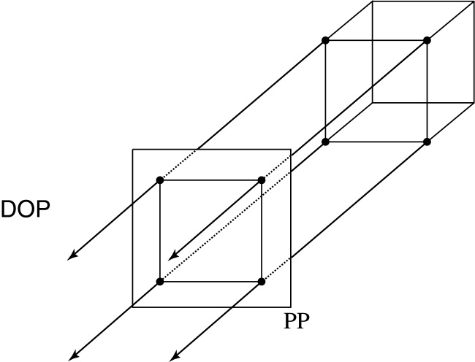
Projections
Projections transform points in n-space to m-space, where m<n.
In 3-D, we map points from 3-space to the projection plane (PP) (a.k.a., image plane) along projectors (a.k.a., viewing rays) emanating from the center of projection (COP):
There are two basic types of projections:
  Perspective – distance from COP to PP finite
  Parallel – distance from COP to PP infinite

Slide 12
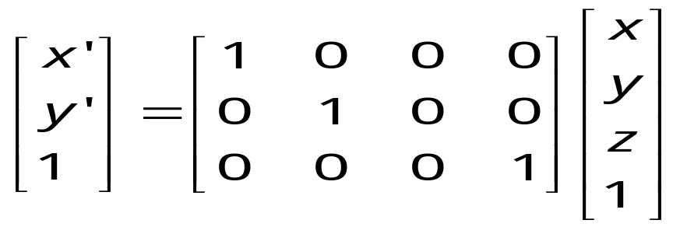
Parallel projections
For parallel projections, we specify a direction of projection (DOP) instead of a COP.
We can write orthographic projection onto the z=0 plane with a simple matrix, such that x’=x, y’=y.
Notes:
Drop z value

Slide 13
Parallel projections
For parallel projections, we specify a direction of projection (DOP) instead of a COP.
We can write orthographic projection onto the z=0 plane with a simple matrix, such that x’=x, y’=y.
Normally, we do not drop the z value right away. Why not?
Notes:
Drop z value
You may wonder, why bother to introduce so many zeros to have a matrix. You will see later the unification reason later.

Slide 14
ALGORITHM
Begine
X← x-z*SXp
Y← y-z*SYp
Return,
End

Slide 15
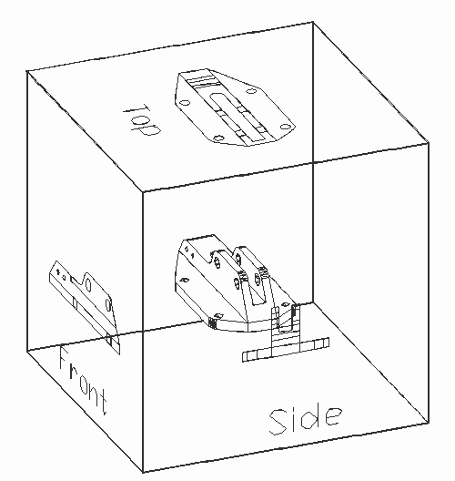
Properties of parallel projection
Properties of parallel projection:
  Are actually a kind of affine transformation
    Parallel lines remain parallel
    Ratios are preserved
    Angles not (in general) preserved
  Not realistic looking
  Good for exact measurements,
  Most often used in
    CAD,
    architectural drawings,
    etc.,
  where taking exact measurement
  is important
Notes:
Scanalyze

Slide 16
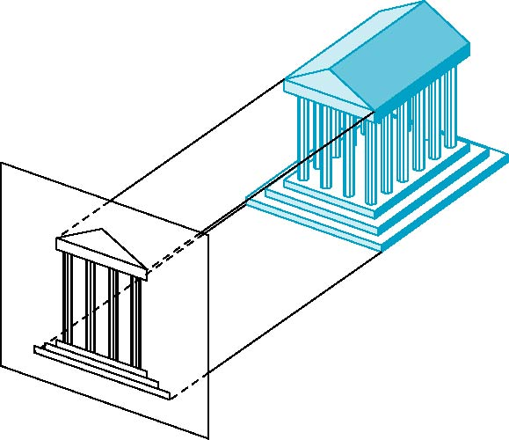
Orthographic Projection
Projectors are orthogonal and perpendicular to projection surface
Xp=X
Yp=Y
xp,yp
(x,y,z)

Slide 17

Multiview Orthographic Projection
Projection plane parallel to principal face
Usually form front, top, side views
isometric (not multiview
orthographic view)
front
in CAD and architecture,
we often display three
multiviews plus isometric
side
top

Slide 18
Axonometric projection is a type of orthographic projection used for creating a pictorial drawing of an object, where the lines of sight are perpendicular to the plane of projection, and the object is rotated around one or more of its axes to reveal multiple sides

Slide 19
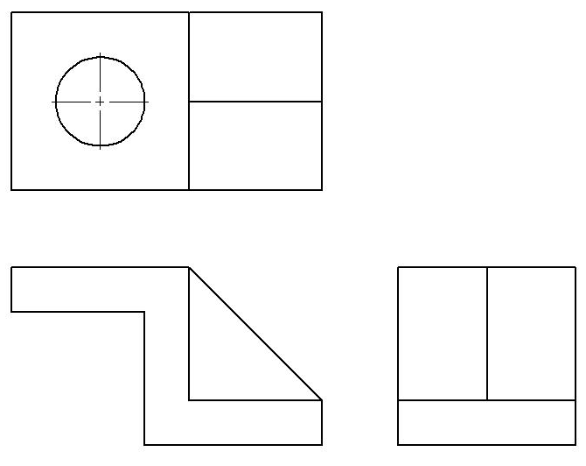
Given This!

Slide 20
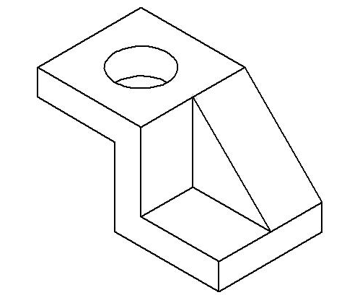
Draw this!

Slide 21
Types of Axonometric Projection
Isometric – has equal foreshortening along each of the three axis directions
Dimetric – has equal foreshortening along two axis directions and a different amount on the third axis
Trimetric – has different foreshortening along all three axis directions

Slide 22
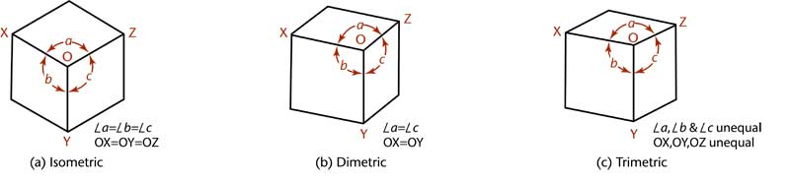
Types of Axonometric Projection

Slide 23
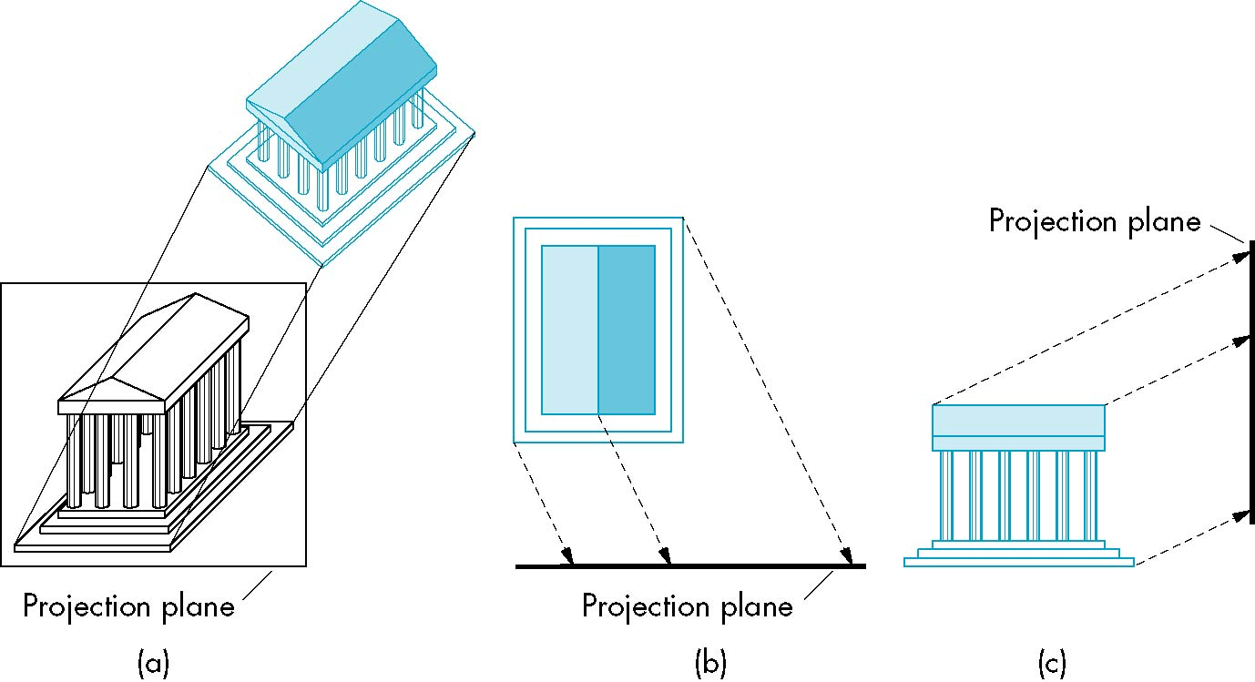
Oblique Projection
Arbitrary relationship between projectors and projection plane. Projection line is parallel but not perpendicular.

Slide 24
Length depend on the angle a and Z coordinate of the point to be projected
Tan a = Z/L
L= Z/Tan A
Xp= X+Z( Lcos 0)
Yp= Y+Z(Lsin 0)
(x,y,z)
(Xp,Yp)
a
L
Y
X
(x,y)

Slide 25
Mparallel= 1 0 Lcos 0 0 X
0 1 Lsin 0 0 Y
0 0 1 0 Z
0 0 0 1 1

Slide 26
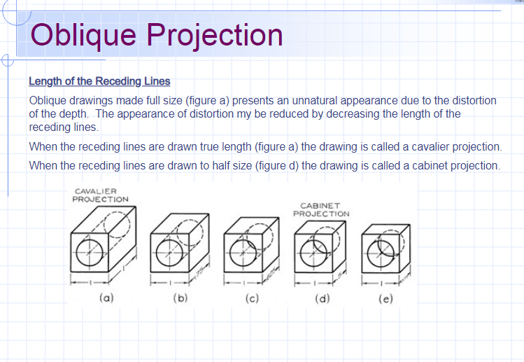

Slide 27
Advantages and Disadvantages
Can pick the angles to emphasize a particular face
  Architecture: plan oblique, elevation oblique
Angles in faces parallel to projection plane are preserved while we can still see “around” side
In physical world, cannot create with simple camera; possible with bellows camera or special lens (architectural)

Slide 28
Perspective Projection
In perspective projection, the distance from the center of projection to project plane is finite and the size of the object varies inversely with distance which looks more realistic.
The distance and angles are not preserved and parallel lines do not remain parallel. Instead, they all converge at a single point called center of projection or projection reference point. There are 3 types of perspective projections which are shown in the following chart.
One point perspective projection is simple to draw.
Two point perspective projection gives better impression of depth.
Three point perspective projection is most difficult to draw.

Slide 29
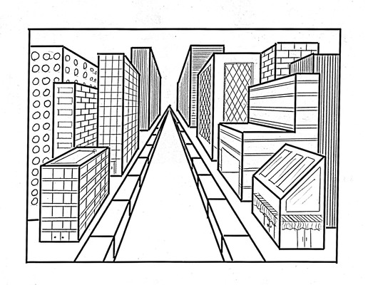
Perspective effect
Notes:
Distant objects are smaller
Paralle lines meet

Slide 30
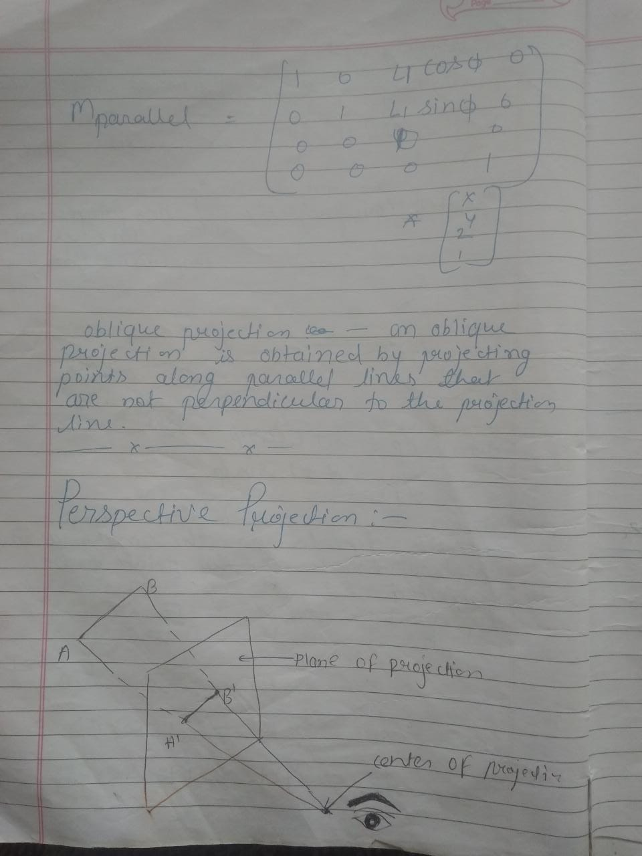

Slide 31
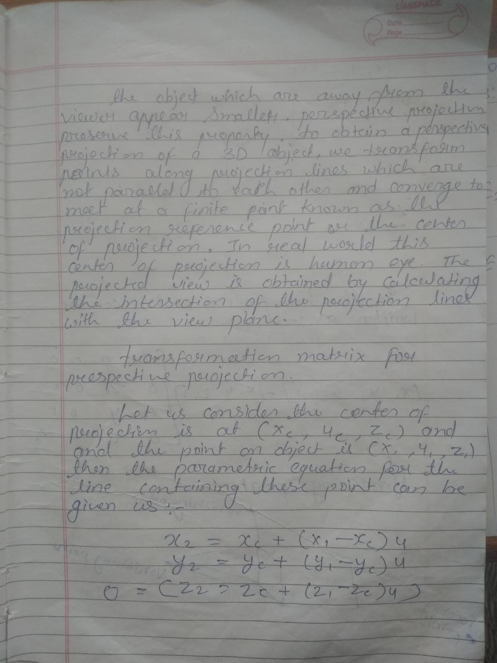

Slide 32
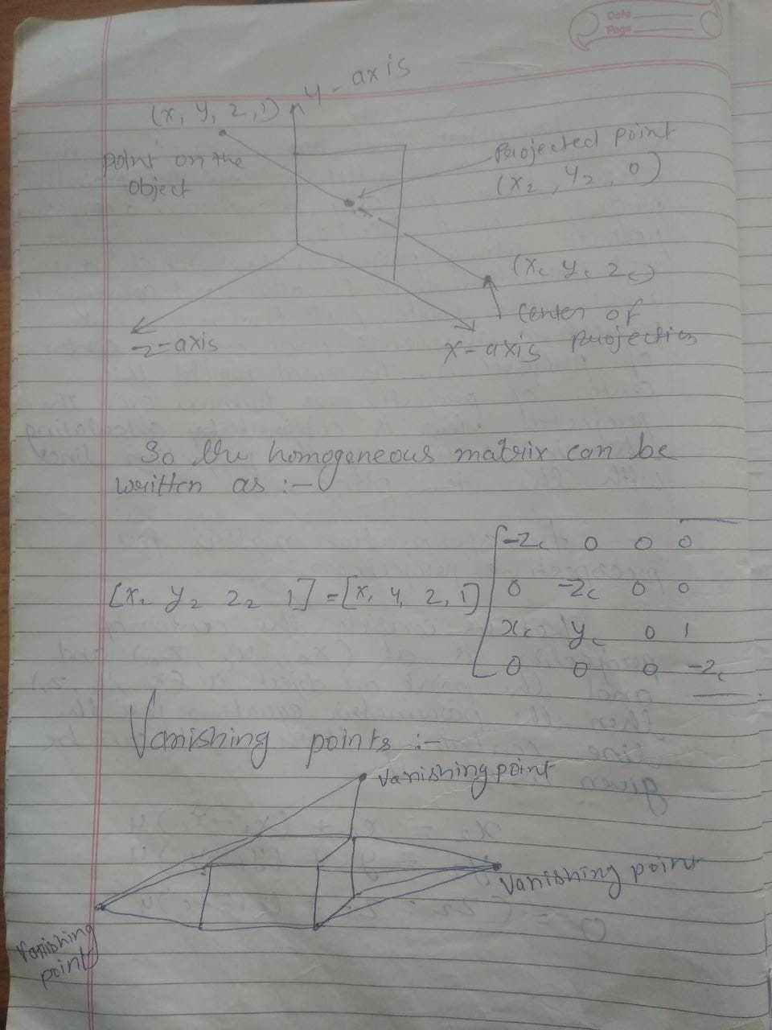

Slide 33
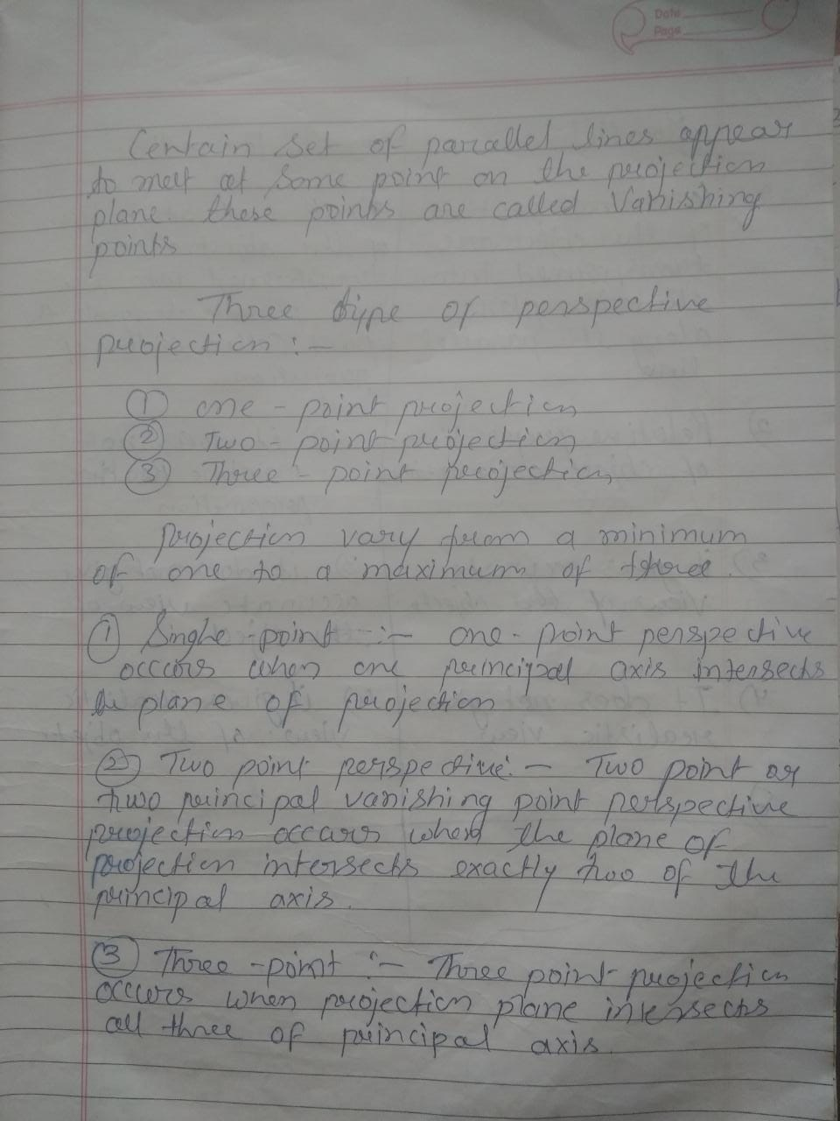

Slide 34
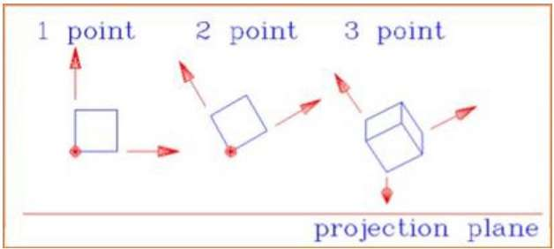

Slide 35
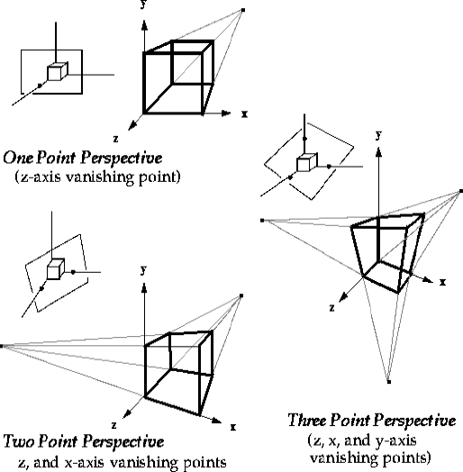
Vanishing points

Slide 36
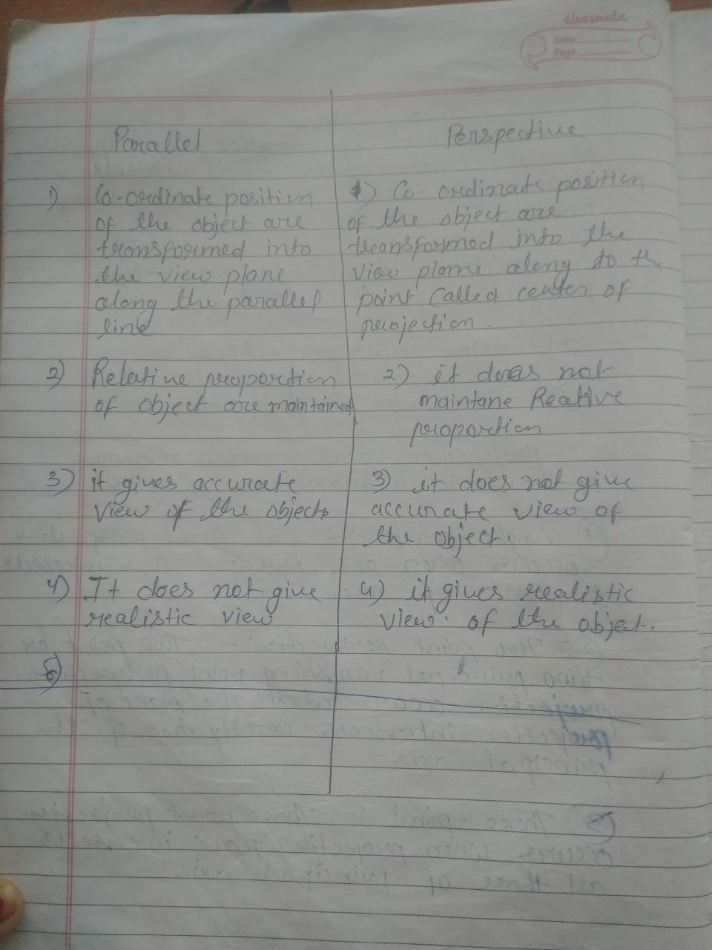

Slide 37
Visible-Surface Detection
(Hidden Surface elimination)
Problem:
Given a scene and a projection,
what can we see?

Slide 38
Visible-Surface Detection
Terminology:
  Visible-surface detection vs. hidden-surface removal
  Hidden-line removal vs. hidden-surface removal
Many algorithms:
  Complexity scene
  Type of objects
  Hardware

Slide 39
Visible-Surface Detection
Two main types of algorithms:
1) Object Space Method
2) Image Space Method
Object space Image space

Slide 40
  Object space: Determine which part of the object are visible. Object space is implemented in the world coordinate system, considering the geometrical relationship with actual image.
  it uses “Line display algorithm”
  Image space: Determine per pixel which point of an object is visible. Image space method implemented in Screen coordinate system, considering relationship between the image of the object in their final pixel level. Visibility decided point by point at each pixel.
  it uses “Image space method”

Slide 41
Visible-Surface Detection
Object space method
  Back-face detection elimination
  Painter’s algorithm(Depth-sorting, Z-Sorting)
  Robert’s algorithm
  Image Space Method
  Depth-buffer
  Ray-casting (ray tracing)
  Area subdivision method
  Octree method
  Scan line method

Slide 42

Back-face elimination
We cannot see the back-face of solid objects:
  Hence, these can be ignored
N
V

Slide 43

Back-face elimination
We cannot see the back-face of solid objects:
  Hence, these can be ignored
V
N

Slide 44
Back-face elimination
Object-space method
Works fine for convex polyhedra: ±50% removed
Concave or overlapping polyhedra: require additional processing
Interior of objects can not be viewed
Partially visible front faces

Slide 45
Depth-Sorting Algorithm
Image and Object space
Aka Painter’s algorithm
Sort surfaces for depth
Draw them back to front

Slide 46
Depth-Sorting Algorithm
Simplistic version sorting:
Sort polygons for (average/frontal) z-value
4
4?
3!
3
3?
4!
2
2?
1!
1
1?
x_{v}
2!
x_{v}
display
display
z_{v}
z_{v}

Slide 47
Depth-Sorting Algorithm
A polygon S can be drawn if all remaining polygons S’ satisfy one of the following tests:
No overlap of bounding rectangles of S and S’
S is completely behind plane of S’
S’ is completely in front of plane of S
Projections S and S’ do not overlap

Slide 48
Depth-Sorting Algorithm
1. No overlap of bounding rectangles of S and S’
y_{v}
S
S
S’
S’
x_{v}
x_{v}
display
z_{v}

Slide 49
Depth-Sorting Algorithm
S is completely behind plane of S’
    Substitute all vertices of S in plane equation S’, and test if the result is always negative.
y_{v}
S
S
S’
S’
x_{v}
x_{v}
display
z_{v}

Slide 50
Depth-Sorting Algorithm
3. S’ is completely in front of plane of S
    Substitute all vertices of S’ in plane equation of S, and test if the result is always positive
y_{v}
S
S
S’
S’
x_{v}
x_{v}
display
z_{v}

Slide 51
Depth-Sorting Algorithm
4. Projections S and S’ do not overlap
y_{v}
S
S’
S
S’
x_{v}
x_{v}
display
z_{v}

Slide 52
Depth-Sorting Algorithm
If all tests fail: Swap S and S’,
and restart with S’.
S’
S
S’’
x_{v}
display
z_{v}

Slide 53
Depth-Sorting Algorithm
Problems: circularity and intersections
Solution: Cut up polygons.
y_{v}
y_{v}
x_{v}
x_{v}

Slide 54
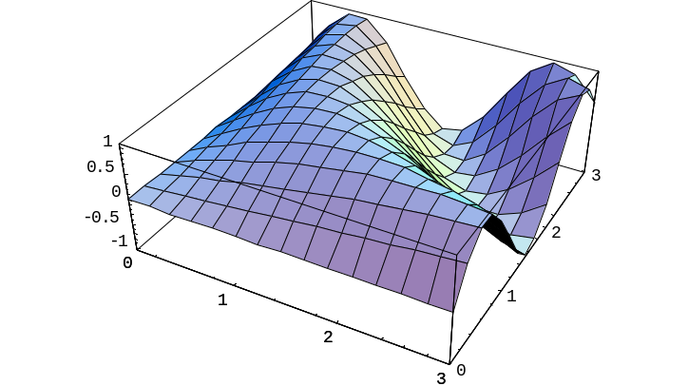
Depth-Sorting Algorithm
- Tricky to implement
- Polygons have to be known from the start
- Slow: ~ #polygons²
+ Fine for certain types of objects, such as plots of z=f(x, y) or non-intersecting spheres
+ Produces exact boundaries polygons

Slide 55
Depth-Buffer Algorithm
Image-space method
Aka z-buffer algorithm
Normalized view volume
Algorithm:
Draw polygons,
Remember the
color most in front.
y_{v}
x_{v}
z_{v}
front =
visible
pixel
View plane

Slide 56
Depth-Buffer Algorithm
var zbuf: array[N,N] of real; { z-buffer: 0=near, 1=far }
fbuf: array[N,N] of color; { frame-buffer }
For all 1<= i, j <=N do
  zbuf[i,j] := 1.0; col[i,j] := BackgroundColour;
For all polygons do { scan conversion }
For all covered pixels (i,j) do
Calculate depth z;
If z < zbuf[i,j] then { closer! }
zbuf[i,j] := z;
fbuf[i,j] := surfacecolor(i,j);
Sorting

Slide 57
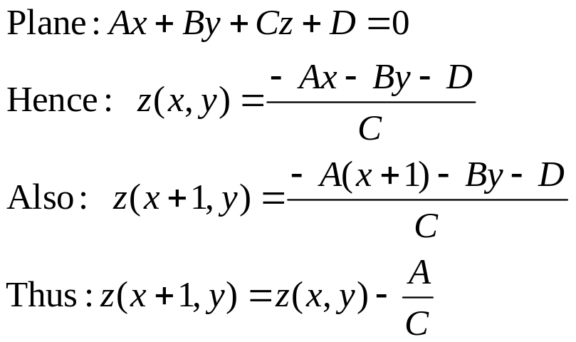
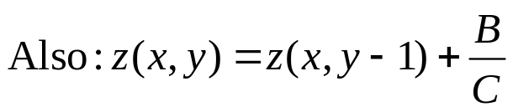
Depth-Buffer Algorithm
Fast calculation z: use coherence.
polygon
scan line
y
x
x+1
display

Slide 58
Depth-Buffer Algorithm
+ Easy to implement
+ Hardware supported
+ Polygons can be processed in arbitrary order
+ Fast: ~ #polygons, #covered pixels
- Costs memory
- Color calculation sometimes done multiple times
- Transparancy is tricky

Slide 59
Ray-casting Algorithm
Image-space method
Related to depth-buffer, order is different
Normalized view volume
Algorithm:
Per pixel:
Calculate intersection points
Determine front one
z
y_{v}
x_{v}
z_{v}
front =
visible
pixel
View plane

Slide 60
Ray-casting Algorithm
Var fbuf: array[N,N] of colour; { frame-buffer }
n : integer; { #intersections }
z : array[MaxIntsec] of real; { intersections }
p : array[MaxIntsec] of object; { corresp. objects }
For all 1<= i, j <=N do { for alle pixels }
For all objects do
Calculate intersections and add these to z and p,
keeping z and p sorted;
if n > 1 then fbuf[i,j] := surfacecolor(p[1], z[1]);

Slide 61
Ray-casting Algorithm
Acceleration intersection calculations:
Use (hierarchical) bounding boxes
z
y_{v}
x_{v}
z_{v}

Slide 62
Ray-casting algorithm 4
+ Relatively easy to implement
+ For some objects very suitable (for instance spheres and other quadratic surfaces)
+ Transparency can be dealt with easily
- Objects must be known in advance
- Sloooow: ~ #objects*pixels, little coherence
+ Special case of ray-tracing
H&B 16-10:518-519

